Slide 1
Unit 1 – Introduction to Raspberry Pi

Slide 2
Contents
Introduction to Raspberry Pi
Why Raspberry pi
Features of Raspberry pi
Different uses of Raspberry pi
Different Versions of Raspberry pi
Different components of the Board
Basic set up and first boot configuration

Slide 3
Introduction to Raspberry Pi
The Raspberry Pi is a series of small single-board computers developed in the United Kingdom.
It is developed by the Raspberry Pi Foundation.
The Raspberry Pi foundation aims to promote teaching of basic computer science in schools and in developing countries.

Slide 4
Introduction to Raspberry Pi
The Raspberry Pi launched in 2012, and there have been several iterations and variations released since then.
The original Pi had a single-core 700MHz CPU and just 256MB RAM, and the latest model has a quad-core 1.4GHz CPU with 1GB RAM.
The main price point for Raspberry Pi has always been $35 and all models have been $35 or less, including the Pi Zero, which costs just $5.

Slide 5
Contents
Introduction to Raspberry Pi
Why Raspberry pi
Features of Raspberry pi
Different uses of Raspberry pi
Different Versions of Raspberry pi
Different components of the Board
Basic set up and first boot configuration

Slide 6
Why Raspberry pi
Raspberry pi is mostly used to provide low cost, high performance computers.
Enable people to learn to use computers, learn coding and solve various problems related to automation.
The Raspberry Pi Foundation earns by selling these computers and uses this money in developing free educational material to help people learn computers and making things with computer.

Slide 7
Why Raspberry pi
Is Raspberry Pi open source?
The Raspberry Pi operates in the open source ecosystem: it runs Linux (a variety of distributions), and its main supported operating system, Raspbian, is open source and runs a suite of open source software.
The Raspberry Pi Foundation contributes to the Linux kernel and various other open source projects as well as releasing much of its own software as open source.
The Raspberry Pi's schematics are released, but the board itself is not open hardware.
The Raspberry Pi Foundation relies on income from the sale of Raspberry Pis to do its charitable work.

Slide 8
Contents
Introduction to Raspberry Pi
Why Raspberry pi
Features of Raspberry pi
Different uses of Raspberry pi
Different Versions of Raspberry pi
Different components of the Board
Basic set up and first boot configuration

Slide 9
Features of Raspberry pi
It features a full-fledged computer that is as big as a credit card.
It has features to do almost everything that a computer can do.
You can make a database server, a web server, a music system from it.
You can also use it to watch videos with up to 4K resolution in up to 2 screens at the same time.
Raspberry Pi can replace most microcontrollers and development boards with its features.

Slide 10
Features of Raspberry pi
Powerful processor:
ADRUINO boards have clock speed of less than 100 MHz, this limits the functions they can perform hence limiting their capabilities.
They are unable to perform as weather stations, cloud server or gaming console.
Pi with powerful processor up to 1.2 GHz and higher ram up to 4 GB can perform all these and many more.
Wireless connectivity:
With Pi 3, it provides not only Bluetooth but also Wi-Fi connectivity.
This makes it possible to set up internet hotspot.
This also makes it ideal to act as a hub between IOT devices and controller server.

Slide 11
Features of Raspberry pi
Dedicated camera port
Pi also has a dedicated camera port.
This makes things easier when working with camera based projects on pi.
Dedicated LCD display port
This eliminates need to have a dedicated monitor.
With modern operating systems that are designed with multiple environments in mind, it can also make keyboard and mouse redundant.
SD card storage
Easy to replace and re-flash.
GPIO
Can be used in robotics.
Linux based
Large Linux community with number of open source applications available for pi.

Slide 12
Contents
Introduction to Raspberry Pi
Why Raspberry pi
Features of Raspberry pi
Different uses of Raspberry pi
Different Versions of Raspberry pi
Vision of Raspberry pi
Different components of the Board
Basic set up and first boot configuration

Slide 13
Different uses of Raspberry pi
General Purpose Computing
Can launch web browser
Access emails, news sites, social networks.
Use free and open source LibreOffice suite to do work processing and spread sheet related work.
Learning Programming
Built in interpreters and compilers for many programming languages.
You can write programs in C, Ruby, Java, Perl and python.
There is even programming language and development environment for creating music called Sonic Pi.

Slide 14
Different uses of Raspberry pi
Project platform
Pi can integrate itself with electronics projects.
You can control LEDs to AC devices and read state of buttons and switches.
Product Prototyping
Linux is increasingly being used in computers and embedded devices.
You may create an embedded product using pi and Linux that may be solving one of the many problems encountered in day-to-day lives.
Retro gaming
Huge community of retro gaming enthusiasts that uses raspberry pi loaded up with RetroPie for emulating old gaming systems such as Nintendo, Game Boy, Atari and DOS.

Slide 15
Contents
Introduction to Raspberry Pi
Why Raspberry pi
Features of Raspberry pi
Different uses of Raspberry pi
Different Versions of Raspberry pi
Different components of the Board
Basic set up and first boot configuration

Slide 16
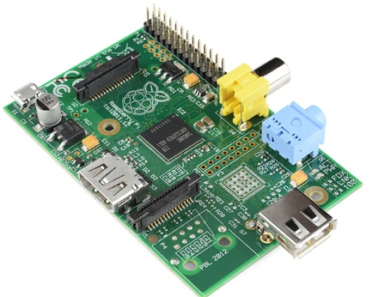
Different Versions of Raspberry pi
The first generation (Raspberry Pi 1 Model B) was released in February 2012, followed by the simpler and cheaper Model A.
In 2014, the Foundation released a board with an improved design, Raspberry Pi 1 Model B+.
These boards are approximately credit-card sized and represent the standard mainline form-factor. Improved A+ and B+ models were released a year later.
A "Compute Module" was released in April 2014 for embedded applications.
The Raspberry Pi 2, which added more RAM, was released in February 2015.

Slide 17
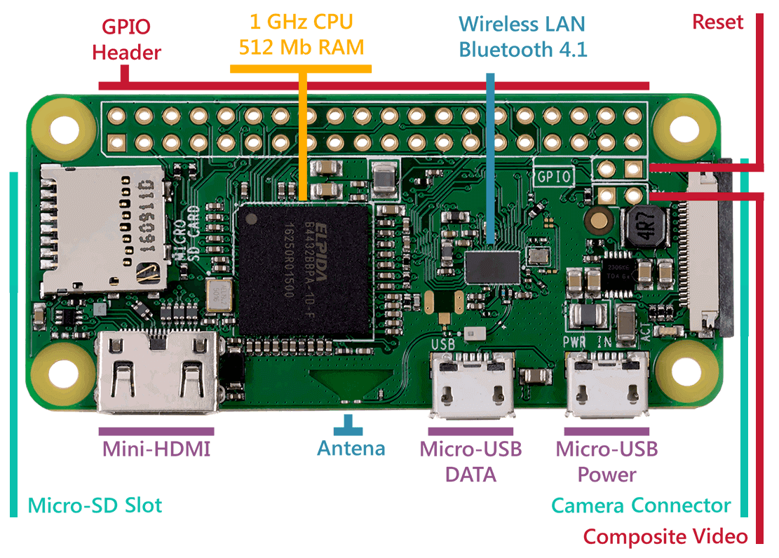
Different Versions of Raspberry pi
A Raspberry Pi Zero with smaller size and reduced input/output (I/O) and general-purpose input/output (GPIO) capabilities was released in November 2015 for US$5. By 2017, it became the newest mainline Raspberry Pi.
On 28 February 2017, the Raspberry Pi Zero W was launched, a version of the Zero with Wi-Fi and Bluetooth capabilities, for US$10.
On 12 January 2018, the Raspberry Pi Zero WH was launched, a version of the Zero W with pre-soldered GPIO headers.

Slide 18
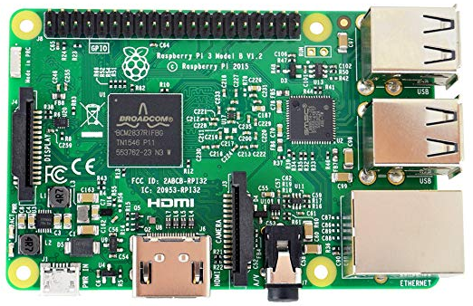
Different Versions of Raspberry pi
Raspberry Pi 3 Model B was released in February 2016 with a 1.2 GHz 64-bit quad core processor, on-board 802.11n Wi-Fi, Bluetooth and USB boot capabilities.
On Pi Day 2018 the Raspberry Pi 3 Model B+ was launched with a faster 1.4 GHz processor and a three-times faster gigabit Ethernet or 2.4 / 5 GHz dual-band 802.11ac Wi-Fi (100 Mbit/s).
Other features are Power over Ethernet (PoE), USB boot and network boot (an SD card is no longer required).

Slide 19
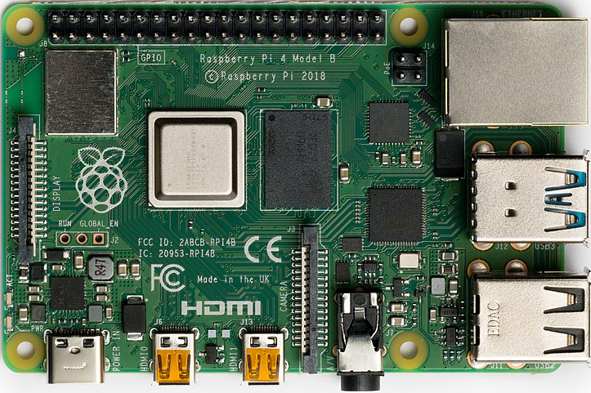
Different Versions of Raspberry pi
Raspberry Pi 4 Model B was released in June 2019 with a 1.5 GHz 64-bit quad core ARM Cortex-A72 processor, on-board 802.11ac Wi-Fi, Bluetooth 5, full gigabit Ethernet, two USB 2.0 ports, two USB 3.0 ports, and dual monitor support (4K resolution).
The Pi 4 is also powered via a USB-C port, enabling additional power to be provided to downstream peripherals, when used with an appropriate PSU.
Three sizes of onboard RAM are available: 1 GB (US$35), 2 GB (US$45), 4 GB (US$55).

Slide 20
Contents
Introduction to Raspberry Pi
Why Raspberry pi
Features of Raspberry pi
Different uses of Raspberry pi
Different Versions of Raspberry pi
Different components of the Board
Basic set up and first boot configuration

Slide 21
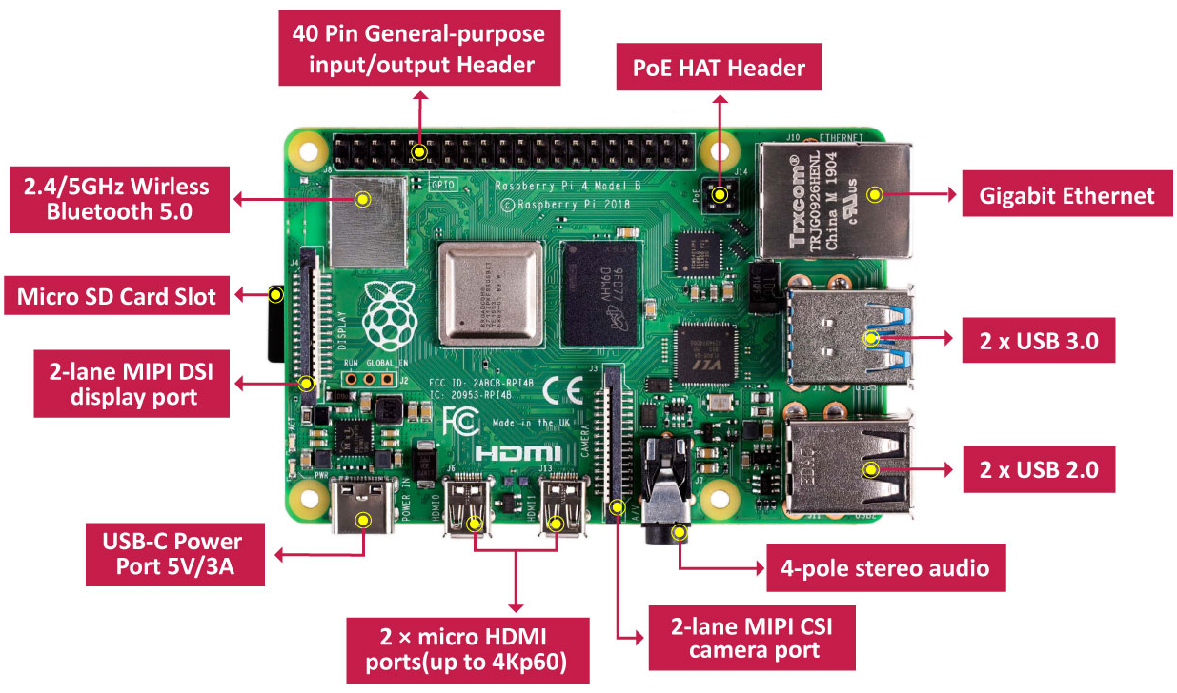
Different components of the Board
Raspberry Pi from top side

Slide 22
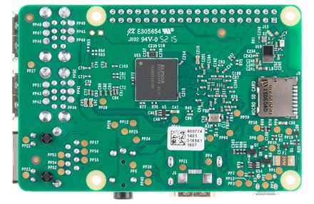
Different components of the Board
Raspberry pi from bottom side

Slide 23
Different components of the Board
The Processor & GPU
Like any computer, the Pi is made up of various different components, each of which has a role to play in making it work.
The first, and arguably most important, of these can be found just above the center point on the top side of the board covered in a metal cap: the system-on-chip (SoC).
The name system-on-chip is a great indicator of what you would find if you pried the metal cover off: a silicon chip, known as an integrated circuit, which contains the bulk of the Raspberry Pi’s system.
This includes the central processing unit (CPU), commonly thought of as the ‘brain’ of a computer, and the graphics processing unit (GPU), which handles the visual side of things

Slide 24
Different components of the Board
RAM
A brain is no good without memory, however, and on the underside of the Raspberry Pi you’ll find exactly that: another chip, which looks like a small, black, plastic square.
This is the Pi’s random access memory (RAM).
When you’re working on the Pi, it’s the RAM that holds what you’re doing; only when you save your work will it be written to the microSD card.
Together, these components form the Pi’s volatile and non-volatile memories: the volatile RAM loses its contents whenever the Pi is powered off, while the non-volatile microSD card keeps its contents.

Slide 25
Different components of the Board
Wireless Communication Module
Turning the board over again you’ll find another metal lid to the upper-right, this one featuring an etched Raspberry Pi logo.
This covers the radio, the component which gives the Raspberry Pi the ability to communicate with devices wirelessly.
The radio itself acts as two main components, in fact: a WiFi radio, for connecting to computer networks; and a Bluetooth radio, for connecting to peripherals like mice and for sending data to or receiving data from nearby smart devices like sensors or smartphones.

Slide 26
Different components of the Board
USB and Network Controller
Another black, plastic-covered chip can be seen to the bottom edge of the board, just behind the middle set of USB ports.
This is the network and USB controller, and is responsible for running the Ethernet port and the four USB ports.
Power unit
A final black chip, much smaller than the rest, can be found a little bit above the micro USB power connector to the upper-left of the board; this is known as a power management integrated circuit (PMIC), and handles turning the power that comes in from the micro USB port into the power the Pi needs to run.

Slide 27
Different components of the Board
USB ports
The Raspberry Pi has a range of ports, starting with four Universal Serial Bus (USB) ports to the middle and right-hand side of the bottom edge.
These ports let you connect any USB-compatible peripheral, from keyboards and mice to digital cameras and flash drives, to the Pi.
Speaking technically, these are known as USB 2.0 ports, which means they are based on version two of the Universal Serial Bus standard.

Slide 28
Different components of the Board
Ethernet Port
To the left of the USB ports is an Ethernet port, also known as a network port.
You can use this port to connect the Raspberry Pi to a wired computer network using a cable with what is known as an RJ45 connector on its end.
If you look closely at the Ethernet port, you’ll see two light-emitting diodes (LEDs) at the bottom; these are status LEDs, and let you know that the connection is working.

Slide 29
Different components of the Board
3.5 mm AV Jack
Just above the Ethernet port, on the left-hand edge of the Raspberry Pi, is a 3.5 mm audio-visual (AV) jack.
This is also known as the headphone jack, and it can be used for that exact purpose.
It has a hidden, extra feature, though: as well as audio, the 3.5 mm AV jack carries a video signal which can be connected to TVs, projectors, and other displays.

Slide 30
Different components of the Board
Camera Interface
Directly above the 3.5 mm AV jack is a strange-looking connector with a plastic flap which can be pulled up; this is the camera connector, also known as the Camera Serial Interface (CSI).
This allows you to use the specially designed Raspberry Pi Camera Module.

Slide 31
Different components of the Board
HDMI Port
Above that, still on the left-hand edge of the board, is the High-Definition Multimedia Interface (HDMI) port, which is the same type of connector you’ll find on a games console, set-top box, and TV.
The multimedia part of its name tells you that it carries both audio and video signals, while high-definition tells you that you can expect excellent quality.
You’ll use this to connect the Raspberry Pi to your display device, whether that’s a computer monitor, TV, or projector.

Slide 32
Different components of the Board
Power Port
Above the HDMI port is a micro USB power port , which you’ll use to connect the Raspberry Pi to a power source.
The micro USB port is a common sight on smartphones, tablets, and other portable devices.
So you could use a standard mobile charger to power the Pi, but for best results you should use the official Raspberry Pi USB Power Supply.

Slide 33
Different components of the Board
Serial Display Connector
At the top edge of the board is another strange-looking connector, which at first glance appears to be identical to the camera connector.
This, though, is the exact opposite: a display connector, or Display Serial Interface (DSI), designed for use with the Raspberry Pi Touch Display.

Slide 34
Different components of the Board
GPIO
At the right-hand edge of the board you’ll find 40 metal pins, split into two rows of 20 pins.
This is the GPIO (general-purpose input/output) header, a feature of the Raspberry Pi used to talk to additional hardware from LEDs and buttons all the way to temperature sensors, joysticks, and pulse-rate monitors.

Slide 35
Different components of the Board
POE
Just below and to the left of this header is another, smaller header with four pins: this is used to connect the Power over Ethernet (PoE) HAT, an optional add-on which lets the Raspberry Pi receive power from a network connection rather than the micro USB socket.

Slide 36
Different components of the Board
Micro SD card slot
There’s one final port on the Raspberry Pi, but you won’t see it on the top.
Turn the board over and you’ll find a microSD card connector on the opposite side of the board to the display connector.
This is the Raspberry Pi’s storage: the microSD card inserted in here contains all the files you save, all the software you install, and the operating system that makes the Raspberry Pi run.

Slide 37
Contents
Introduction to Raspberry Pi
Why Raspberry pi
Features of Raspberry pi
Different uses of Raspberry pi
Different Versions of Raspberry pi
Different components of the Board
Basic set up and first boot configuration

Slide 38
Basic set up and first boot configuration
What you will need?
A power supply
To connect to a power socket, all Raspberry Pi models have a USB port (the same found on many mobile phones): either USB-C for Raspberry Pi 4, or micro USB for Raspberry Pi 3, 2 and 1.
At least 3.0 amps for Raspberry Pi 4
At least 2.5 amps for Raspberry Pi 3
A microSD card
Your Raspberry Pi needs an SD card to store all its files and the Raspbian operating system.
You need a microSD card with a capacity of at least 8 GB.
Many sellers supply SD cards for Raspberry Pi that are already set up with Raspbian and ready to go.

Slide 39
Basic set up and first boot configuration
What you will need?
A keyboard and a mouse
To start using your Raspberry Pi, you need a USB keyboard and a USB mouse.
Once you’ve set your Pi up, you can use a Bluetooth keyboard and mouse, but you’ll need a USB keyboard and mouse for the first setup.
A TV or computer screen
To view the Raspbian desktop environment, you need a screen, and a cable to link the screen and the Pi.
The screen can be a TV or a computer monitor. If the screen has built-in speakers, the Pi is able to use these to play sound.
HDMI
The Raspberry Pi has a HDMI output port that is compatible with the HDMI port of most modern TVs and computer monitors.
Many computer monitors may also have DVI or VGA ports.
Raspberry Pi 4 has two micro HDMI ports, allowing you to connect two separate monitors.
You need either a micro HDMI-to-HDMI cable, or a standard HDMI-to-HDMI cable plus a micro HDMI-to-HDMI adapter, to connect Raspberry Pi 4 to a screen.
Raspberry Pi 1, 2 and 3 have a single full-size HDMI port, so you can connect them to a screen using a standard HDMI-to-HDMI cable.

Slide 40
Basic set up and first boot configuration
What you will need?
DVI
If your screen has a DVI port, you can connect the Pi to it using a HDMI-to-DVI cable.
VGA
Some screens only have a VGA port.
To connect your Pi to such a screen, you can use a HDMI-to-VGA adapter.
A TV or computer screen
To view the Raspbian desktop environment, you need a screen, and a cable to link the screen and the Pi.
The screen can be a TV or a computer monitor. If the screen has built-in speakers, the Pi is able to use these to play sound.

Slide 41
Basic set up and first boot configuration
Optional extras
A case
You may want to put your Raspberry Pi in a case.
This is not essential, but it will provide protection for your Raspberry Pi.
Headphones or speakers
The large Raspberry Pi models (but not Pi Zero/Zero W) have a standard audio port like the one on your smart phone or MP3 player.
If you want to, you can connect your headphones or speakers so that your Raspberry Pi can play sound.
If the screen you’re connecting your Raspberry Pi to has built-in speakers, Raspberry Pi can play sound through these.

Slide 42
Basic set up and first boot configuration
Optional extras
An Ethernet cable
The large Raspberry Pi models (but not Pi Zero/Zero W) have a standard Ethernet port to connect them to the internet; to connect Pi Zero to the internet, you need a USB-to-Ethernet adaptor.
Raspberry Pi 4, 3, and Pi Zero W can also be wirelessly connected to the internet.

Slide 43
Basic set up and first boot configuration
Setting up SD card
If you have an SD card that doesn’t have the Raspbian operating system on it yet, or if you want to reset your Raspberry Pi, you can easily install Raspbian yourself.
To do so, you need a computer that has an SD card port — most laptop and desktop computers have one.
Format SD card on computer → Download Noobs from official PI site →unzip the file and copy all the contents on the SD card.
To install the microSD card, which is the Raspberry Pi’s storage, turn the Raspberry Pi over and slide the card into the microSD slot with the label facing away from the Pi.

Slide 44
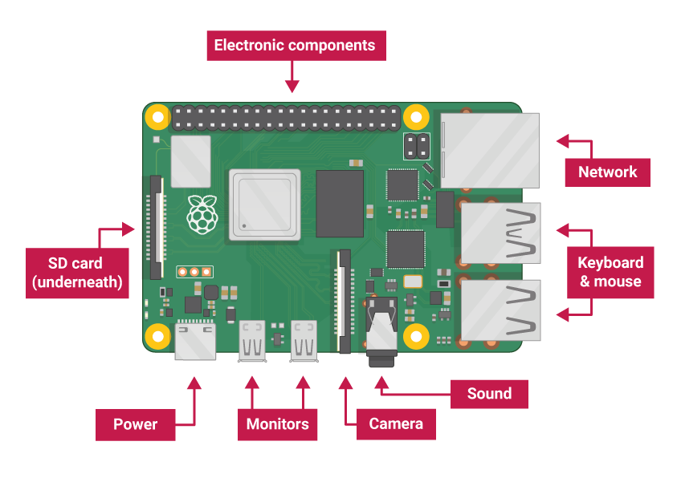
Basic set up and first boot configuration
Connect your Raspberry Pi
Now get everything connected to your Raspberry Pi. It’s important to do this in the right order, so that all your components are safe.

Slide 45
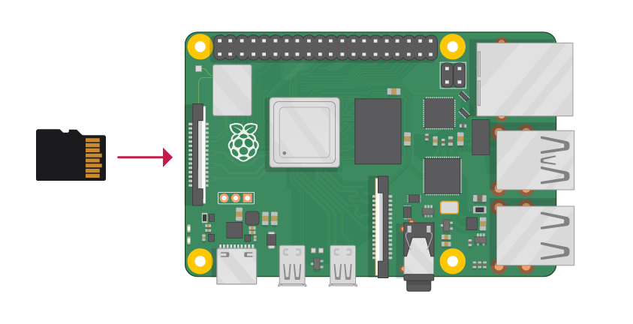
Basic set up and first boot configuration
Connect your Raspberry Pi
Insert the SD card you’ve set up with Raspbian (via NOOBS) into the microSD card slot on the underside of your Raspberry Pi.

Slide 46
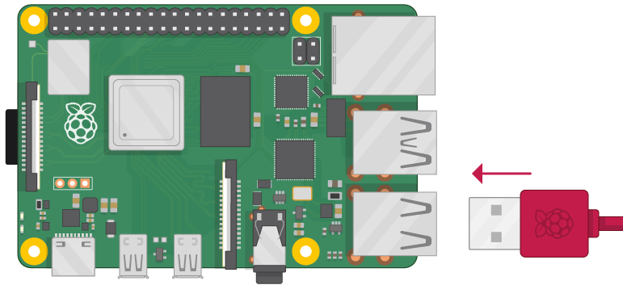
Basic set up and first boot configuration
Connect your Raspberry Pi
Find the USB connector end of your mouse’s cable, and connect the mouse to a USB port on Raspberry Pi (it doesn’t matter which port you use).

Slide 47
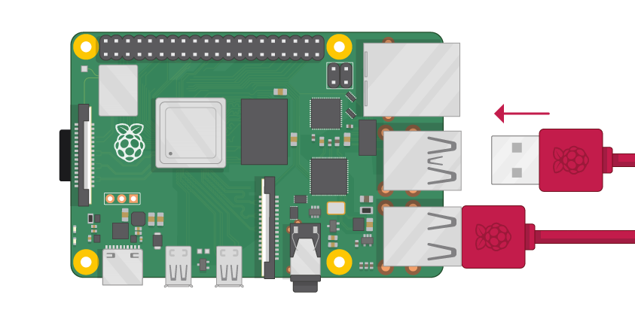
Basic set up and first boot configuration
Connect your Raspberry Pi
Connect the keyboard in the same way.

Slide 48
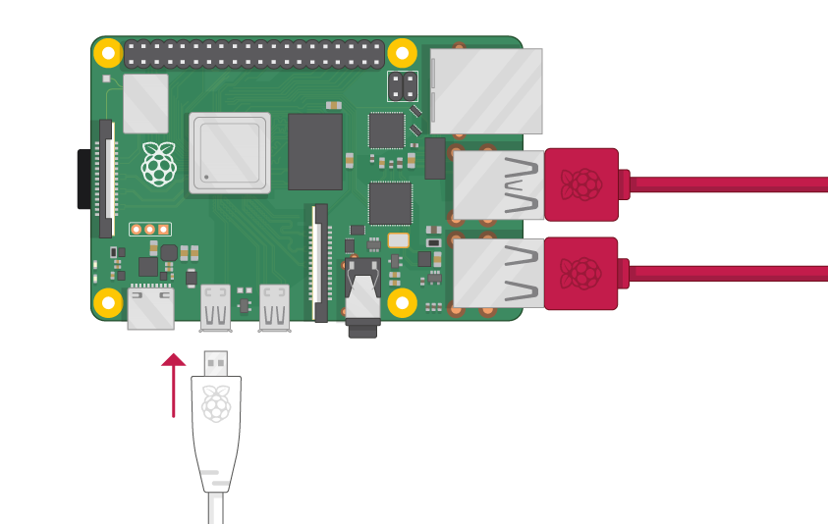
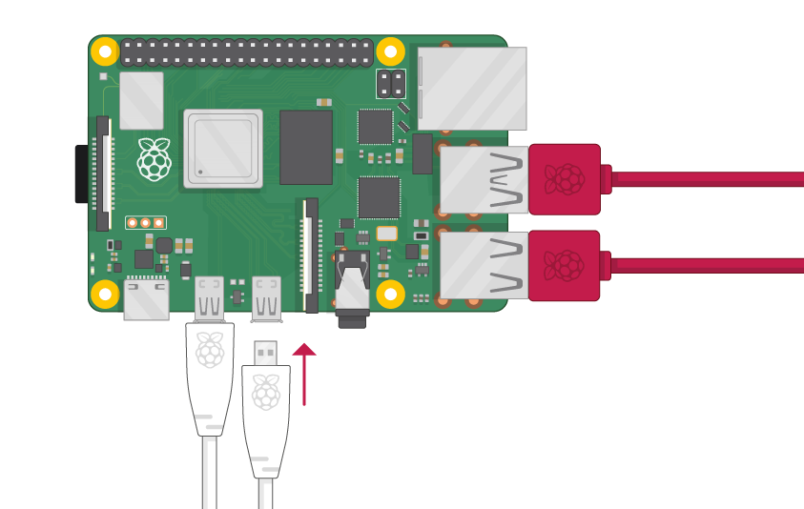
Basic set up and first boot configuration
Connect your Raspberry Pi
Make sure your screen is plugged into a wall socket and switched on.
Look at the HDMI port(s) on the Raspberry Pi — notice that they have a flat side on top.
Use a cable to connect the screen to Raspberry Pi’s HDMI port — use an adapter if necessary.
Raspberry Pi 4 : Connect your screen to the first of Raspberry Pi 4’s HDMI ports, labelled HDMI0.
You can connect an optional second screen in the same way.

Slide 49
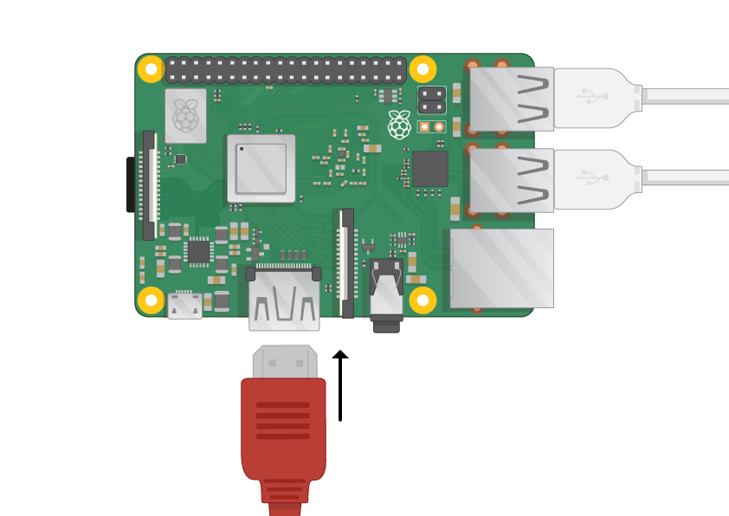
Basic set up and first boot configuration
Connect your Raspberry Pi
Make sure your screen is plugged into a wall socket and switched on.
Look at the HDMI port(s) on the Raspberry Pi — notice that they have a flat side on top.
Use a cable to connect the screen to Raspberry Pi’s HDMI port — use an adapter if necessary.
Raspberry Pi 1, 2, 3
Connect your screen to the single HDMI port.
Note: nothing will display on the screen, because your Raspberry Pi is not running yet.

Slide 50
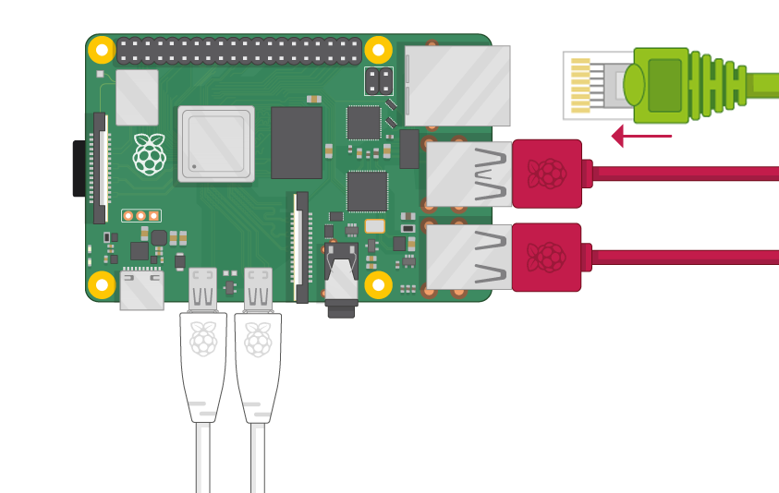
Basic set up and first boot configuration
Connect your Raspberry Pi
If you want to connect your Raspberry Pi to the internet via Ethernet, use an Ethernet cable to connect the Ethernet port on Raspberry Pi to an Ethernet socket on the wall or on your internet router.
You don’t need to do this if you want to use wireless connectivity, or if you don’t want to connect to the internet.

Slide 51
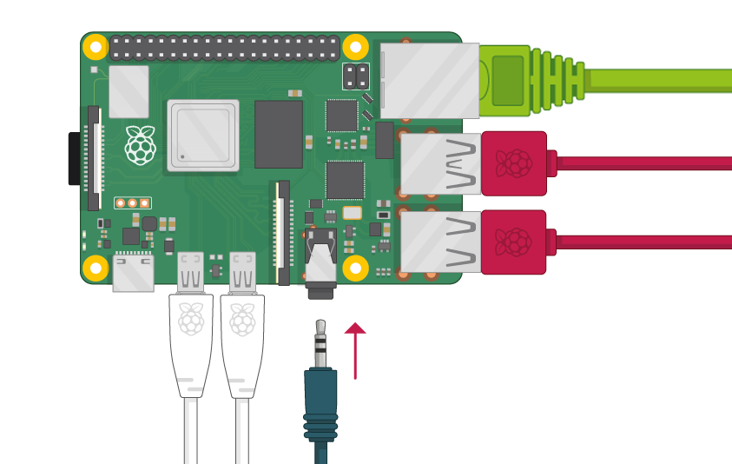
Basic set up and first boot configuration
Connect your Raspberry Pi
If the screen you are using has speakers, sound will play through those. Alternatively, connect headphones or speakers to the audio port if you prefer

Slide 52
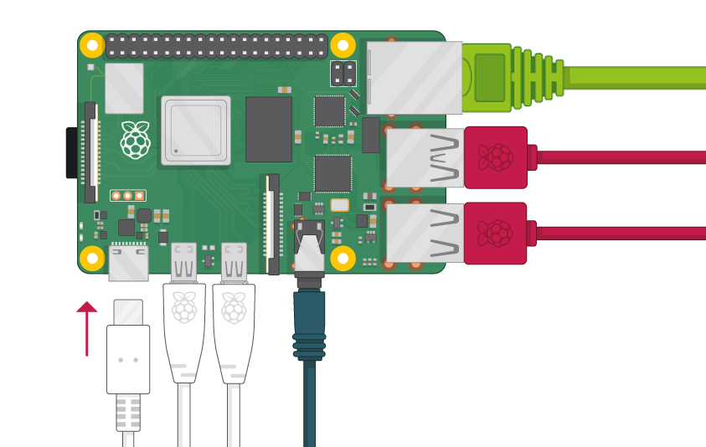
Basic set up and first boot configuration
Start up your Raspberry Pi
Your Raspberry Pi doesn’t have a power switch: as soon as you connect it to a power outlet, it will turn on.
Plug the USB power supply into a socket and connect it to your Raspberry Pi’s power port.

Slide 53

Basic set up and first boot configuration
Start up your Raspberry Pi
You should see a red LED light up on the Raspberry Pi, which indicates that Raspberry Pi is connected to power.
As it starts up (this is also called booting), you will see raspberries appear in the top left-hand corner of your screen.

Slide 54
Basic set up and first boot configuration
Start up your Raspberry Pi
After a few seconds the Raspbian Desktop will appear.

Slide 55
Basic set up and first boot configuration
Finish the setup
When you start your Raspberry Pi for the first time, the Welcome to Raspberry Pi application will pop up and guide you through the initial setup.
Click Next to start the setup.
Set your Country, Language, and Timezone, then click Next again.

Slide 56
Basic set up and first boot configuration
Finish the setup
Enter a new password for your Raspberry Pi and click Next.
pi wizard password.

Slide 57
Basic set up and first boot configuration
Finish the setup
Connect to your WiFi network by selecting its name, entering the password, and clicking Next.
Note: if your Raspberry Pi model doesn’t have wireless connectivity, you won’t see this screen.

Slide 58
Basic set up and first boot configuration
Finish the setup
Click Next let the wizard check for updates to Raspbian and install them (this might take a little while).
Click Done or Reboot to finish the setup.
Note: you will only need to reboot if that’s necessary to complete an update.
➔

